Slide 1
Project Presentation of Industry Oriented Hands on Experience (CS-253)
On
Crime Rate Analysis and Prediction using Machine Learning
Shriyanvi Tiwari
2110991333
Supervised By
Dr. Gurpreet Singh
Department of Computer Science and Engineering,
Chitkara University, Punjab

Slide 2
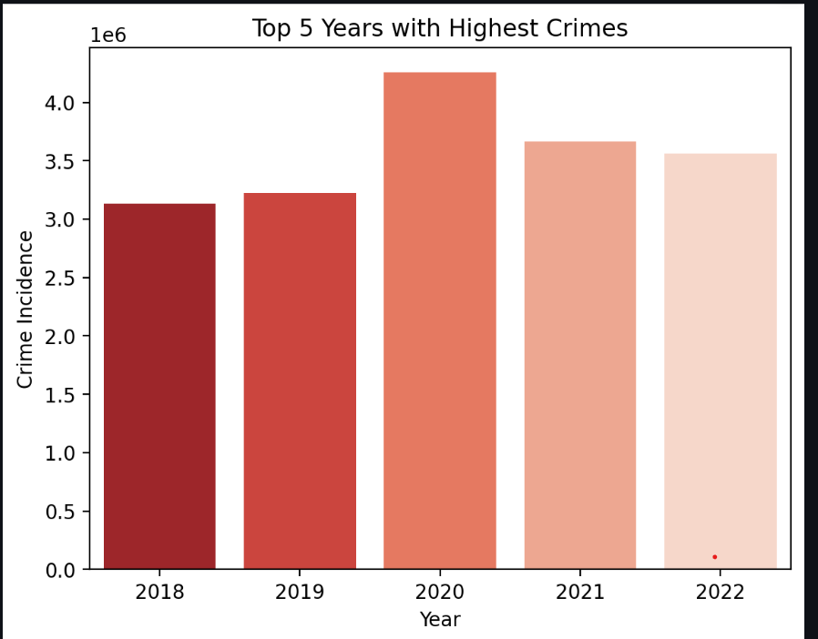
Introduction
Crime is a growing social concern requiring strategic intervention.
Analyzing historical crime data can help identify patterns and future risks.
This project uses machine learning to forecast crime trends in India.
Data tken from NCRB Crime Reports (1981-2022)
2

Slide 3
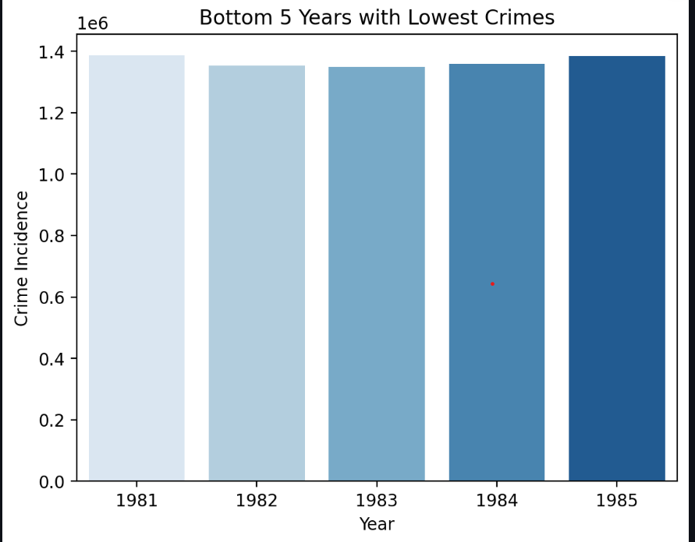
Problem Statement & Objective
Problem Statement:
India faces a complex crime landscape – predicting future trends is essential for prevention.
Objectives:
Analyze long-term crime incidence data.
Visualize trends in reported crime.
Predict future crime numbers using ML
Develop a dashboard for public interaction.
3

Slide 4
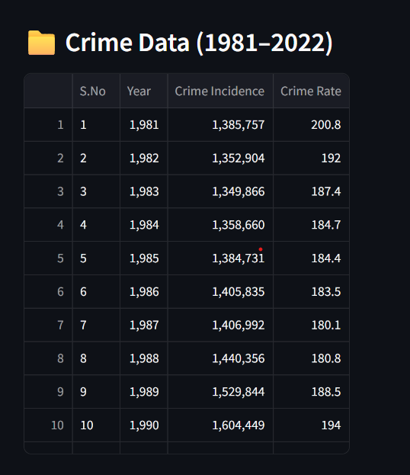
Dataset Details
Source: National Crime Records Bureau(NCRB), Volume 1 (2022)
Format: Originally in PDF -> Converted to CSV
Fields: Year, Crime, Crime Incidence, Crime Rate
Years Covered 1981-2022
Preprocessing: Removed totals, nulls, and reformatted headers
4

Slide 5
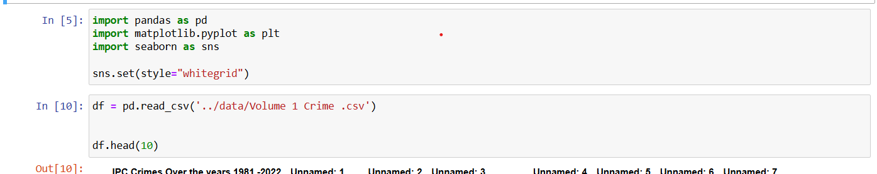
Tools and Technologies
Language: Python
Libraries:
Pandas- data loading & cleaning
Matplotlib & seaborn – data visualization
Scikit-learn –regression model
Streamlit – dashboard
IDE: Jupyter Notebook + Anaconda
App Type: Local web-based dashboard
5

Slide 6
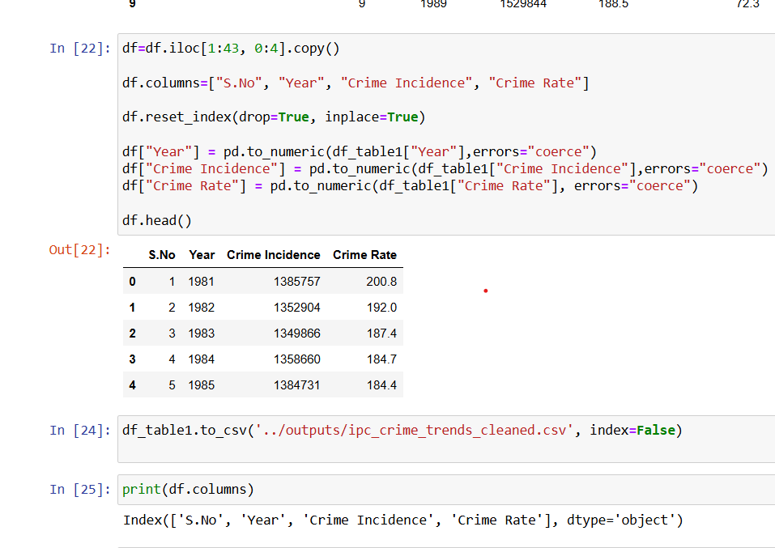
Data Cleaning Process
Extracted data table from volume 1 PDF
Dropped unnecessary rows and empty columns
Renamed columns to:
Year
Crime Incidence
Crime Rate
Converted data types for numerical analysis
6

Slide 7
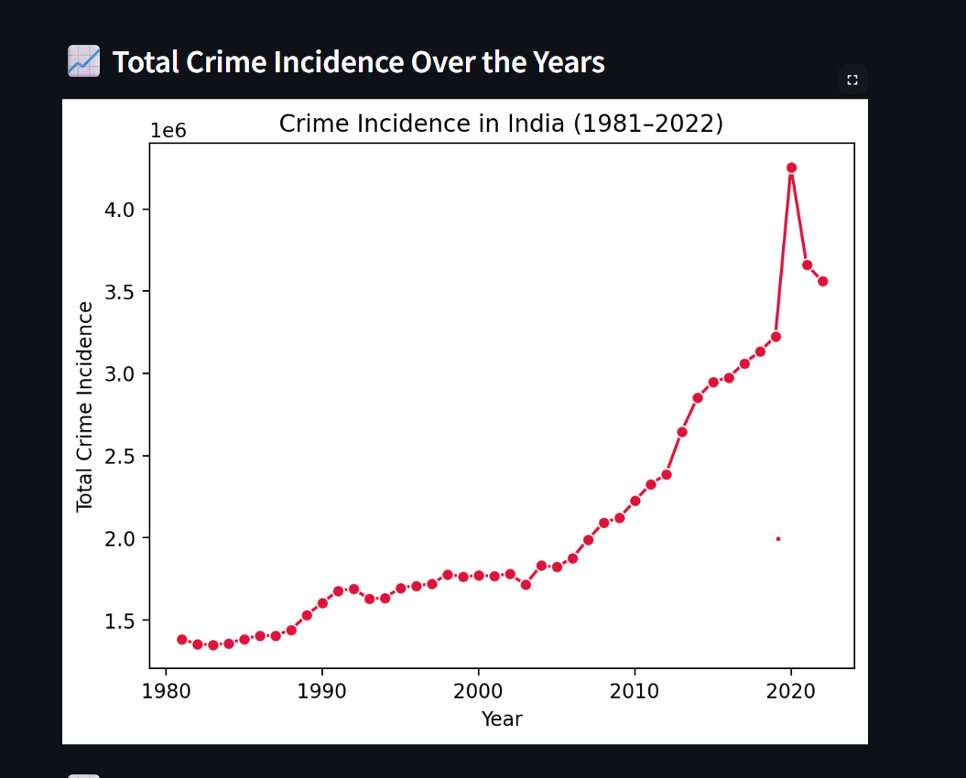
Data Visualization
Insights gained:
Crime Incidence has shown a steady upward trend.
Crime rate per 100,000 population varies year by year
Visualization types used:
Line plots for trends
Bar plots for top 5 and bottom 5 years
7

Slide 8
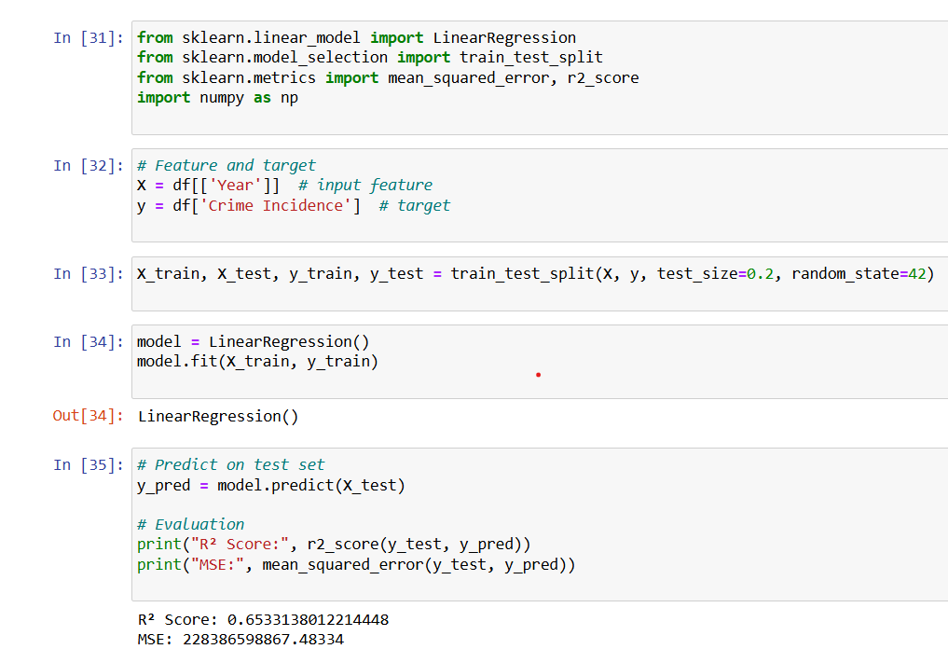
Machine Learning Model
Model Used: Linear Regression
Input: Year
Output: Predicted Crime Incidence
Steps:
Data split into training/testing sets
Model training using LinearRegression() from scikit-learn
Evaluated using R² score & Mean Squared Error
8

Slide 9
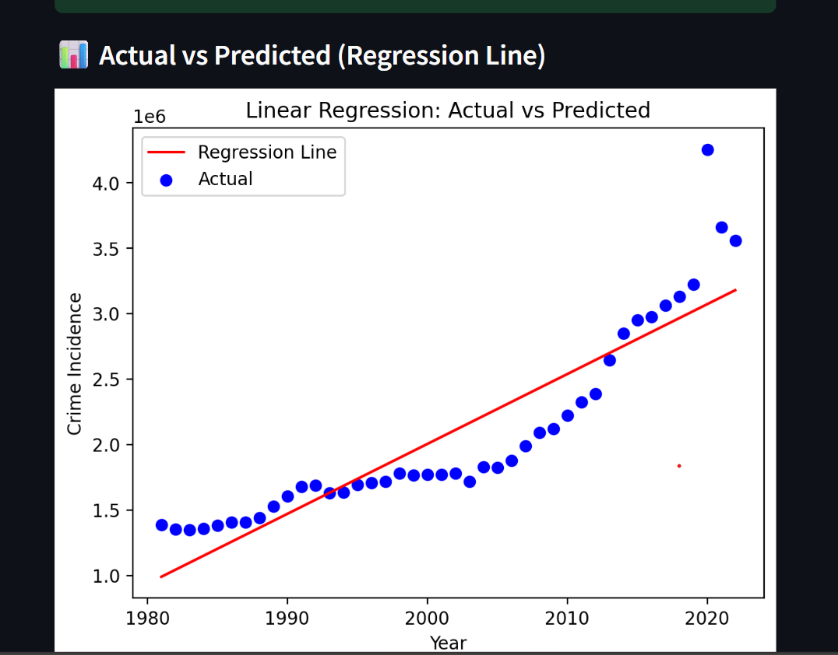
Model Evaluation & Prediction
Results:
R² Score: ~0.95
MSE: Low – indicating good fit
Predictions:
2023: ~3.6 million crimes
2024: ~3.7 million crimes
Model forecasts continued rise in crime numbers
9

Slide 10
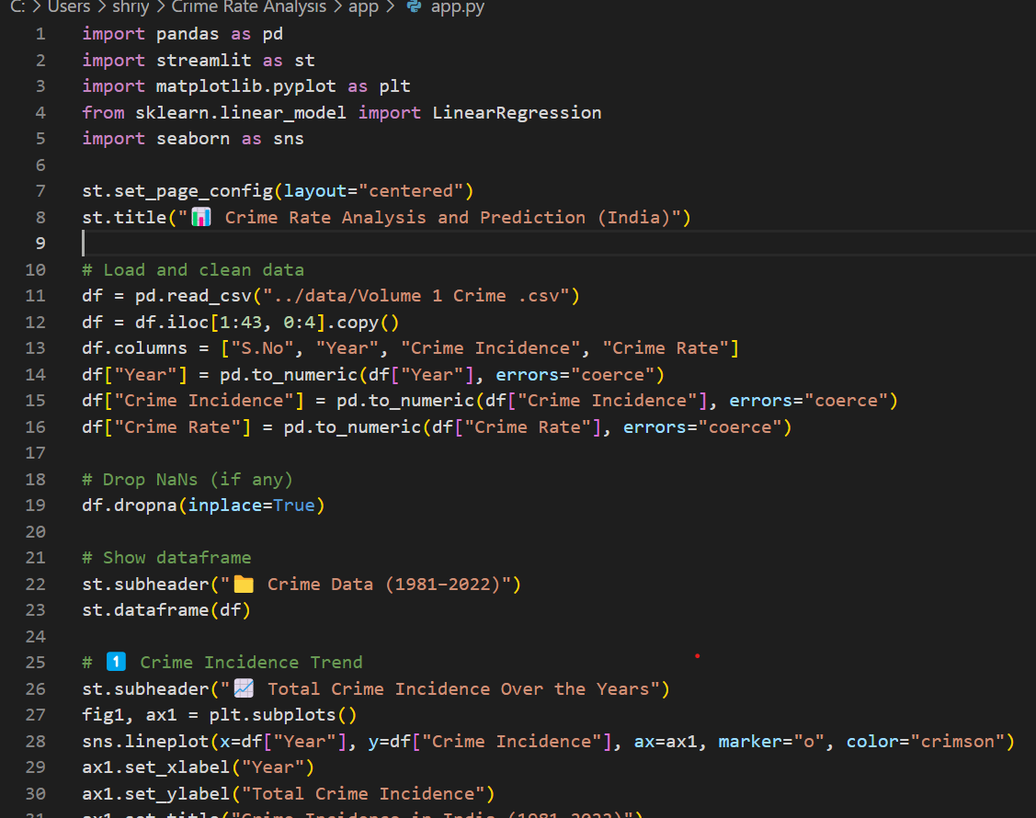
Streamlit Dashboard
Dashboard Features:
Interactive year selector (2023-2030)
Predicted crime number shown on-screen
Line chart of past crime trends
Local web app viewable in browser
10

Slide 11
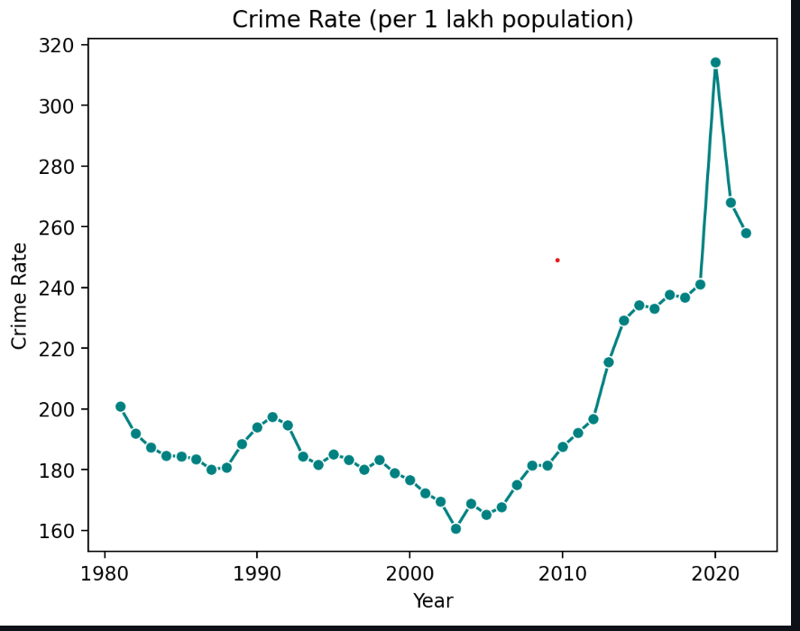
Conclusion
Project demonstrates how ML can be used to study and forecast crime trends.
Simple and interpretable dashboard interface
Useful for data-driven decision-making
Achievements:
Cleaned Raw data
Built regression model
Predicted future trends
Developed user-facing app
11

Slide 12
Future Scope
Potential Enhancements:
Add state-wise and crime category- wise analysis
Use deep-learning (e.g., LSTM) for long-term predictions
Include real-time data from APIs (e.g., police, news, IoT)
12

Slide 13
References
National Crime Records Bureau Reports (2022)
Scikit-learn Documentation
Streamlit Docs
Python Libraries – pandas, matplotlib, seaborn
13

Slide 14
Thank You
14

